Slide 1


COVID-19 Projection and Policies for Ontario
MIE-1624 – Final Exam Project
December 18, 2020
TUSHAR AGGARWAL

Slide 2
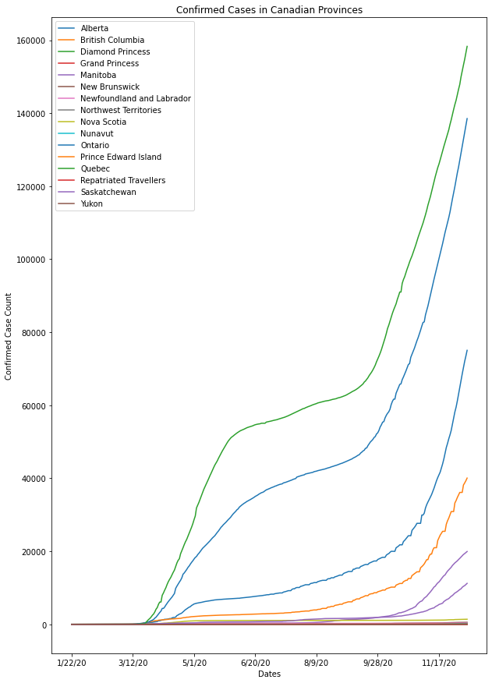
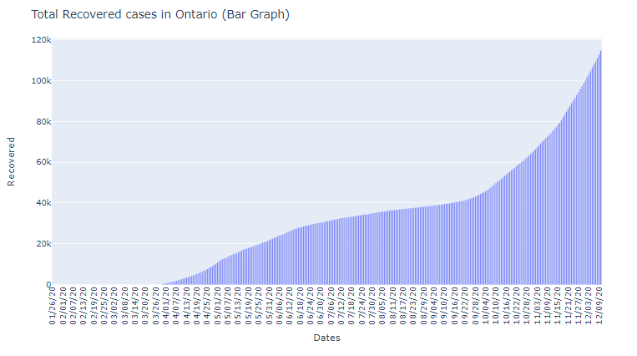
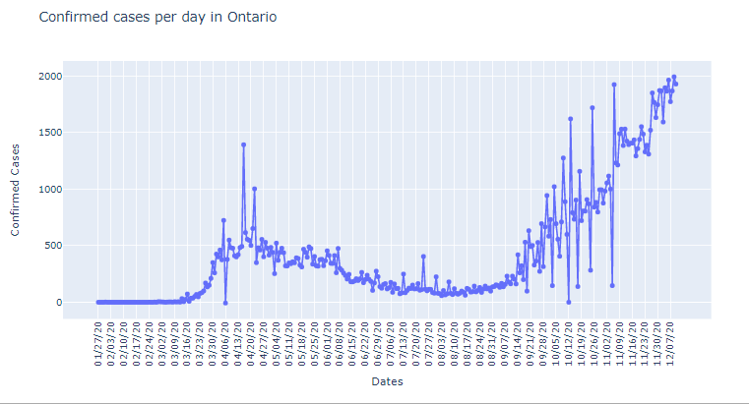
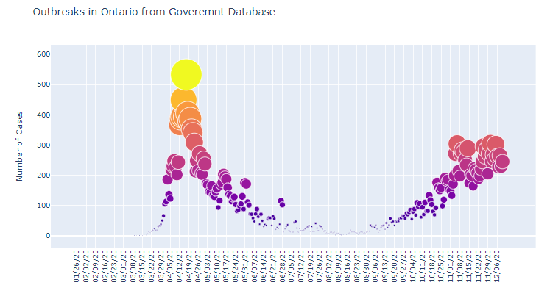
Covid-19 Analysis for Ontario
Ontario
Looking at confirmed cases per day we see Ontario has seen 2 Covid Waves. One was in March 2020 the second one is currently going on since September where daily cases are rising.
We Also see after the first wave we see an upward trend in COVID recovered cases. Which shows that the immunity is starting to increase in the population with more than 100 thousand people have recovered by December 2020
Looking at the data of outbreaks recorded in Ontario we see significant number of outbreaks in March of 2020 and we also see a very high number of outbreaks starting to occur in November. Which correlates to our Covid-19 cases per day data where we see a wave in March and a second wave starting in September
Ontario is the second highest province in Canada with Covid-19 Cases

Slide 3
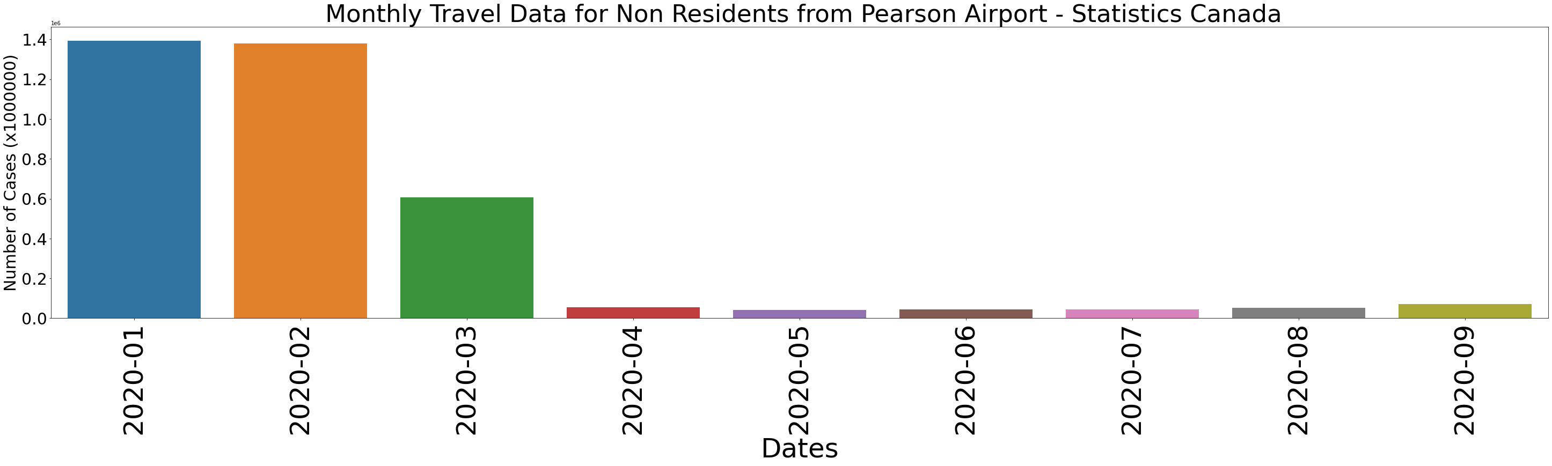
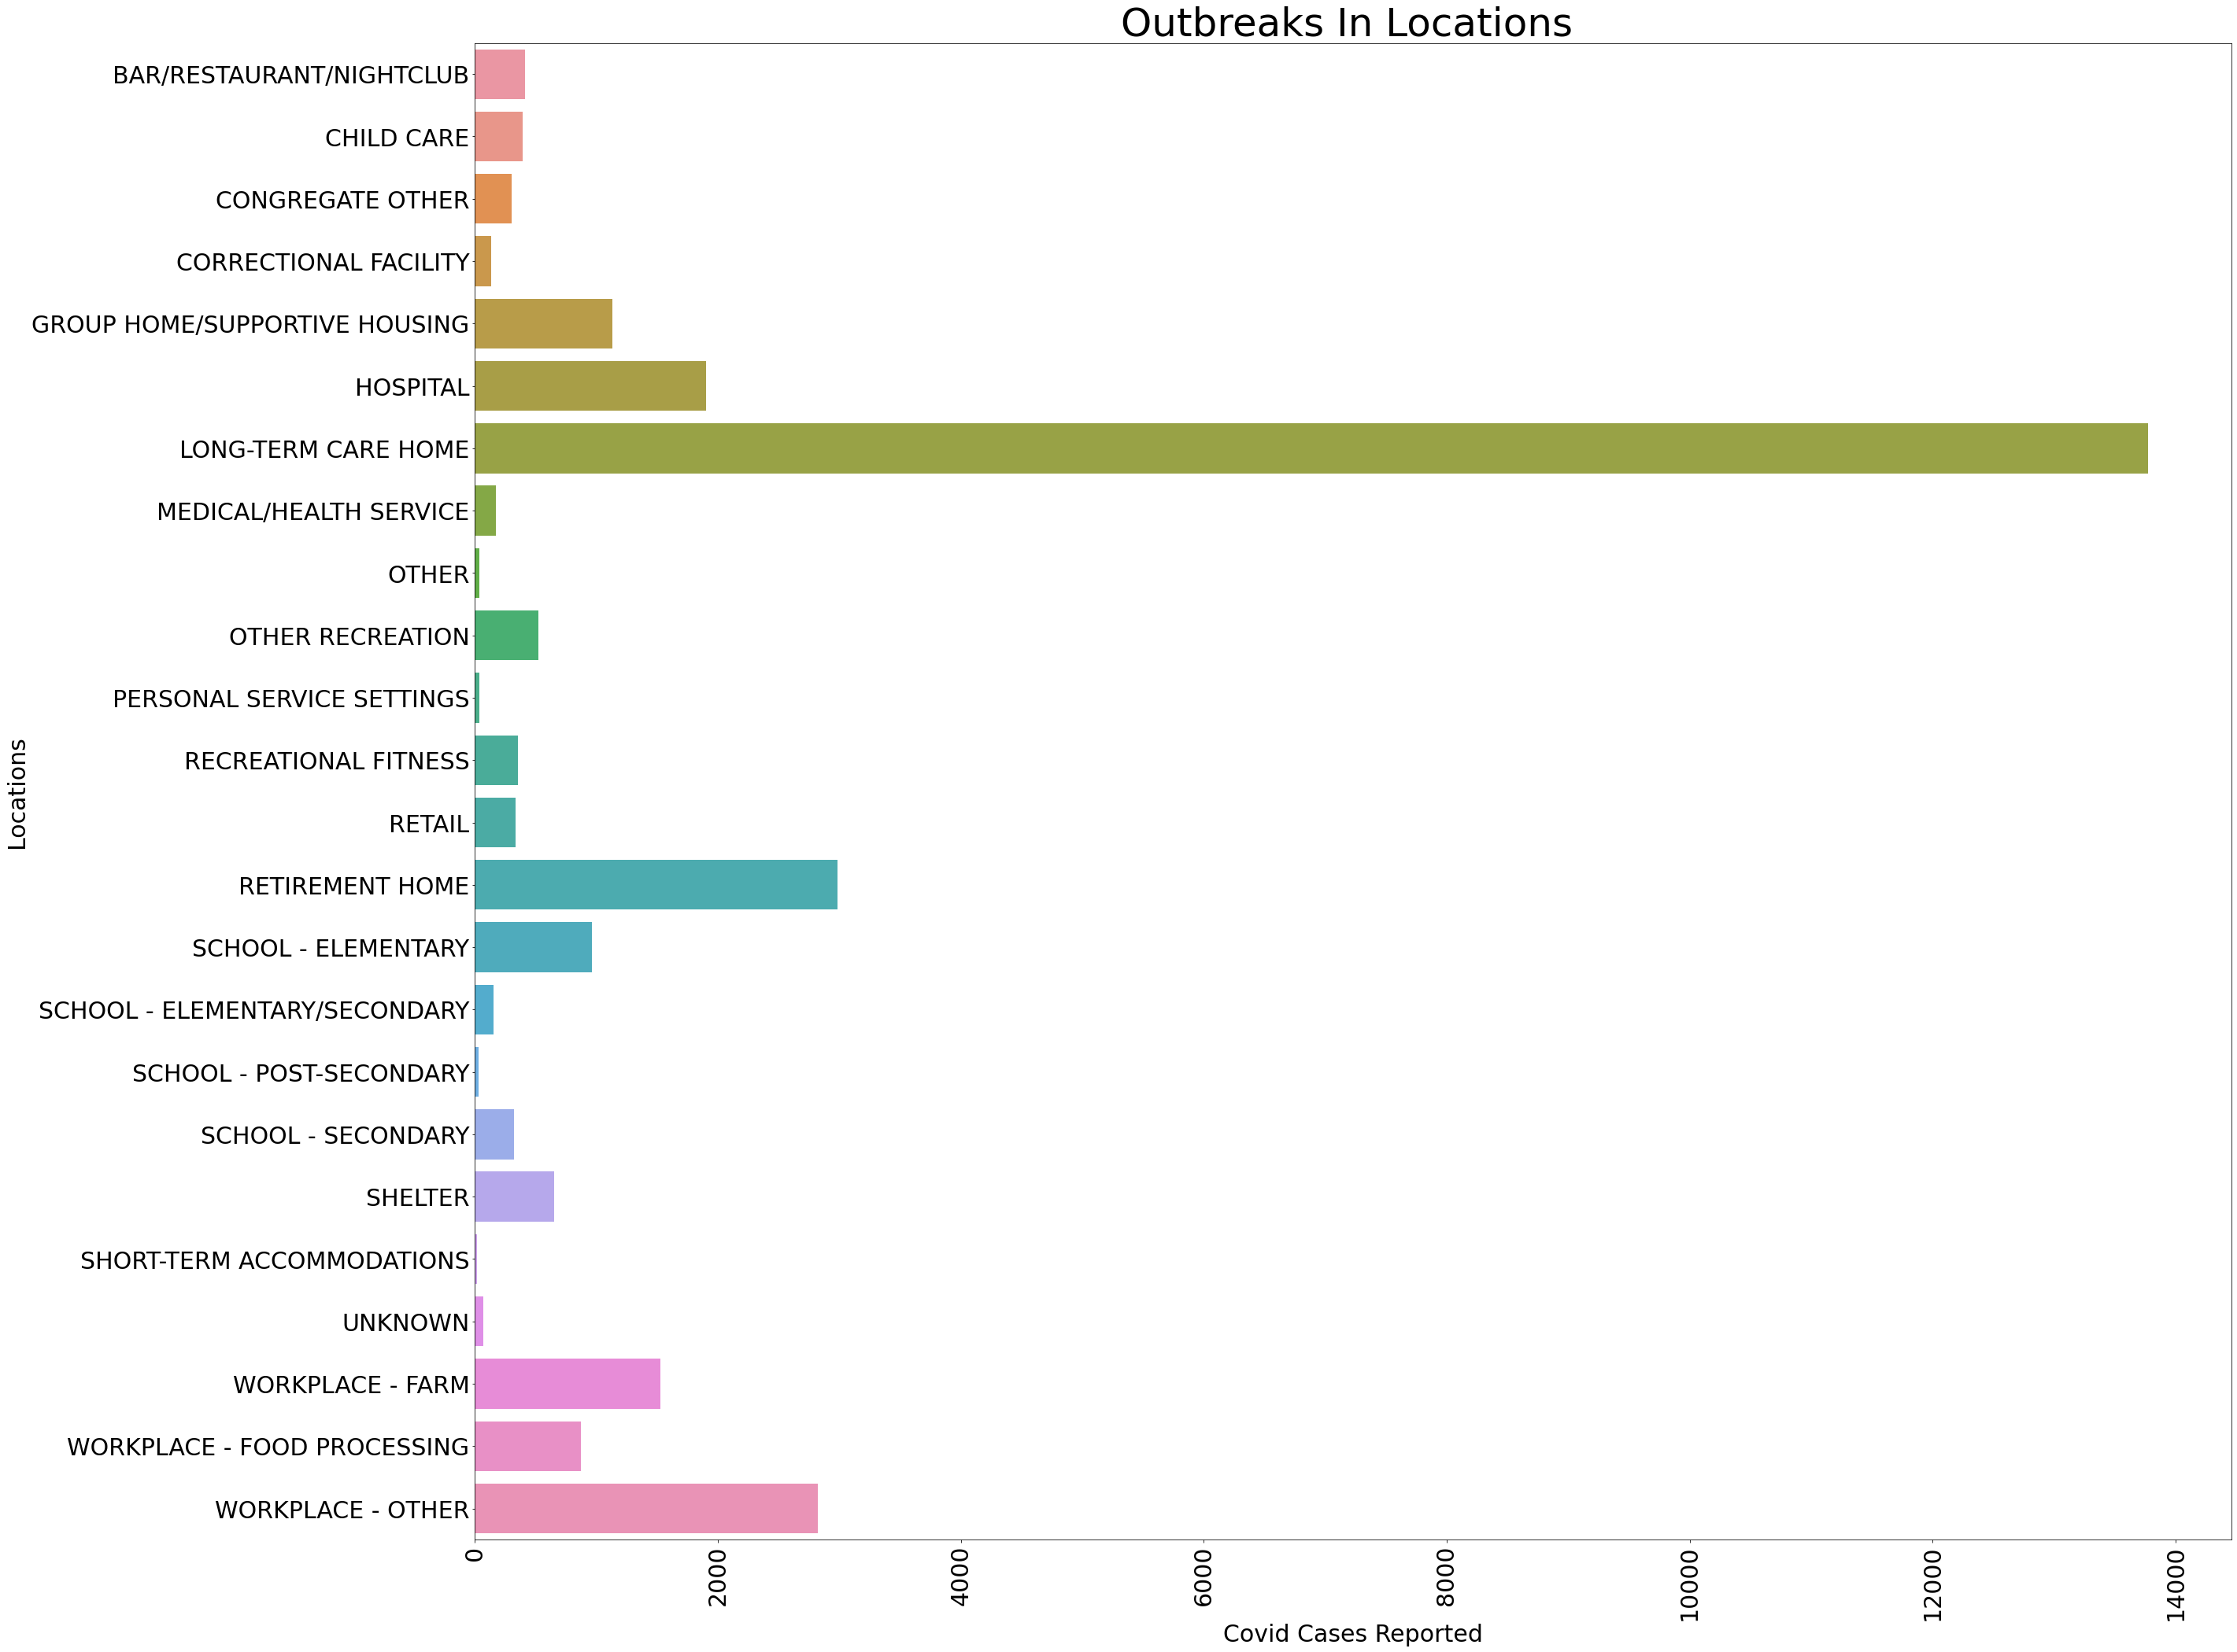
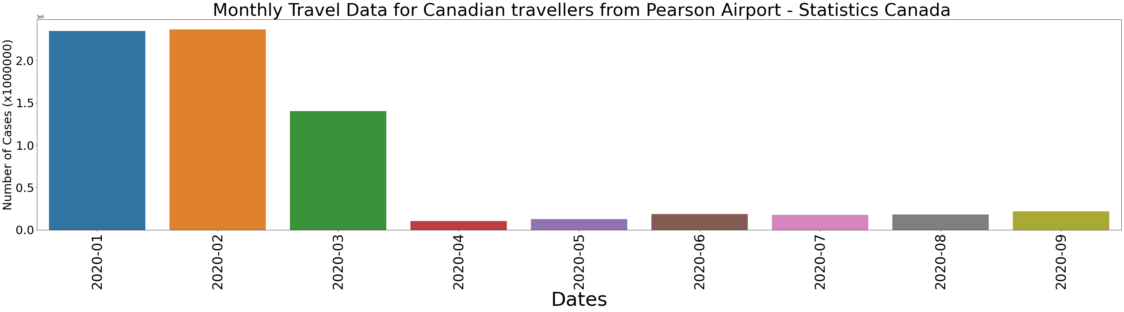
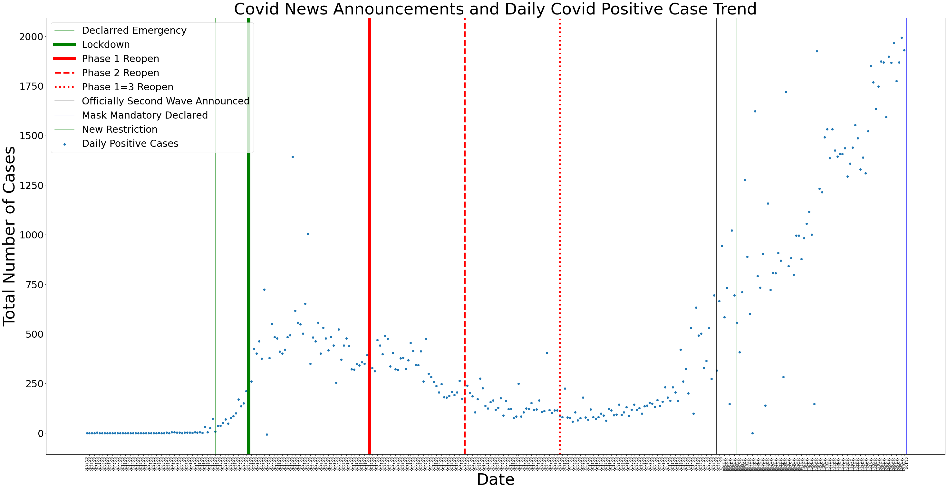
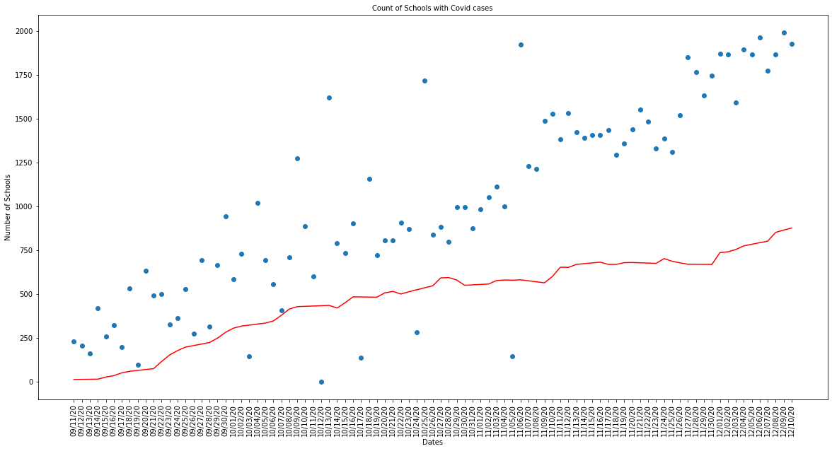
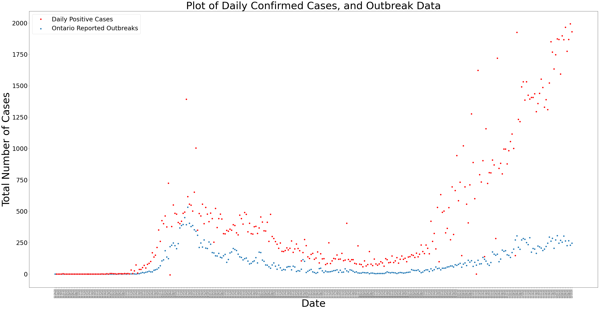
Ontario Outbreak
Ontario Toronto Pearson Travel Data From Statistics Canada
- We see a significant decline in travel after March 2020
Reduced COVID-19 Cases
However, some people are still travelling
Slow increase in travel from April to September 2020
No Data Available after September 2020
School
Schools re-opening had a significant impact on the COVID-19 cases
Whereas lockdown in March (See Date Map) helped reduce spread of covid-19

Slide 4
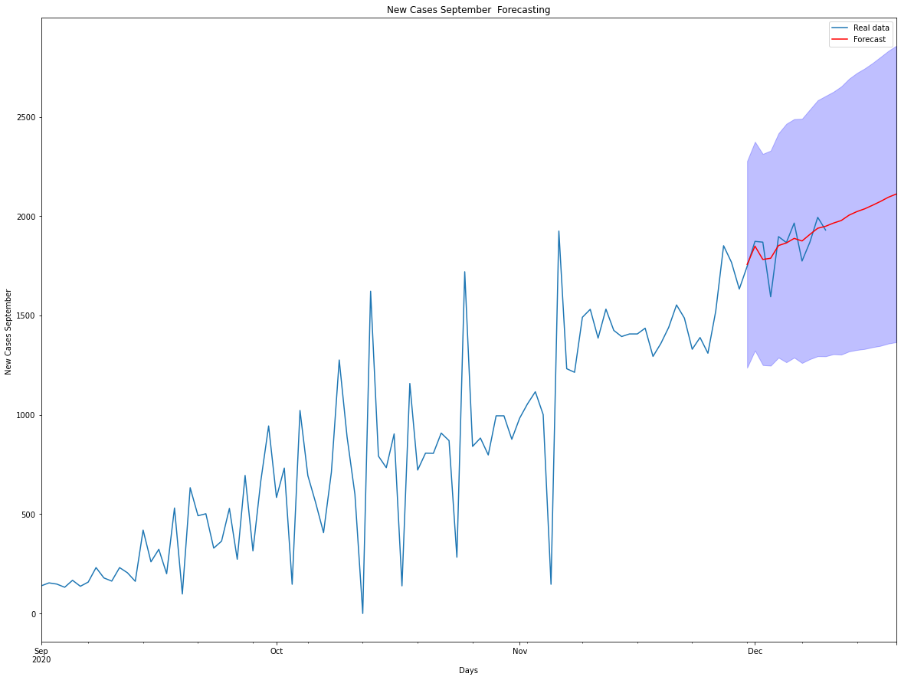
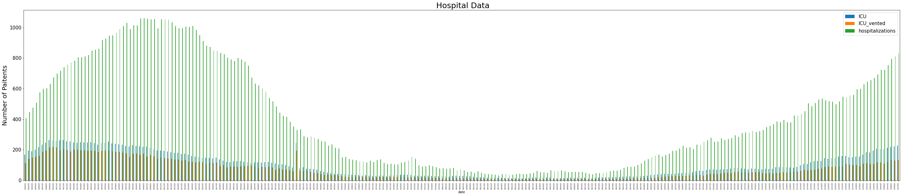
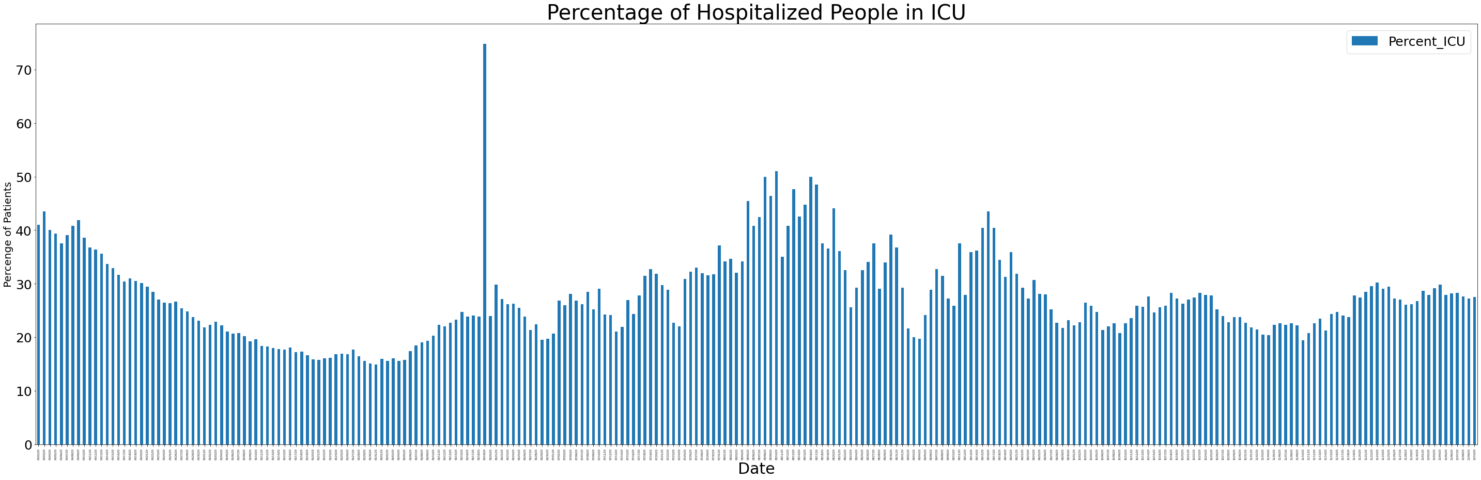
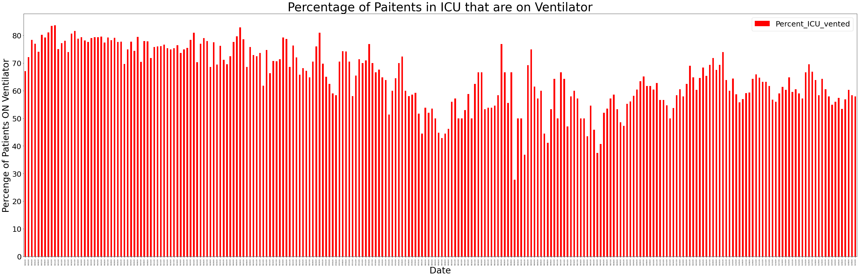
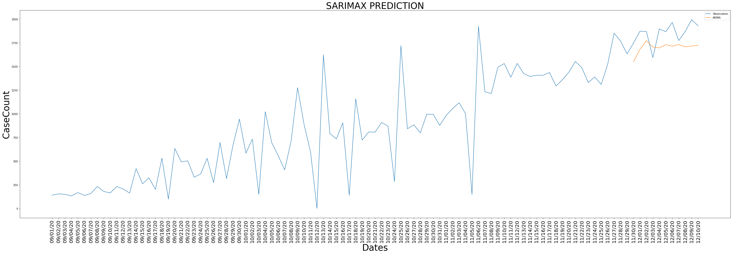
Ontario Hospitalization , ICU Occupancy and ICU with Ventilators
Modelling Second Wave - ARIMA
Modelling Second Wave - SARIMAX

Slide 5
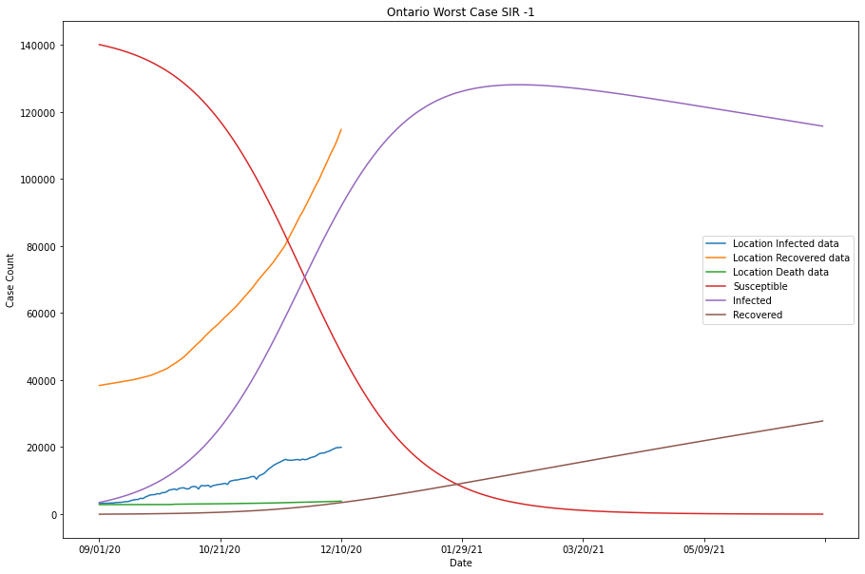
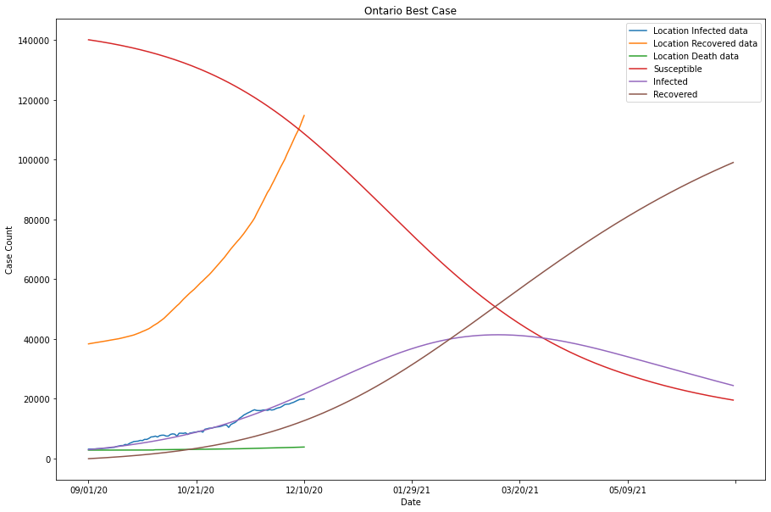
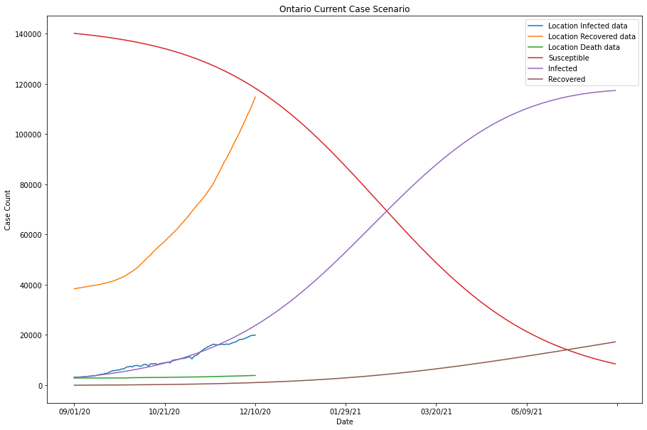
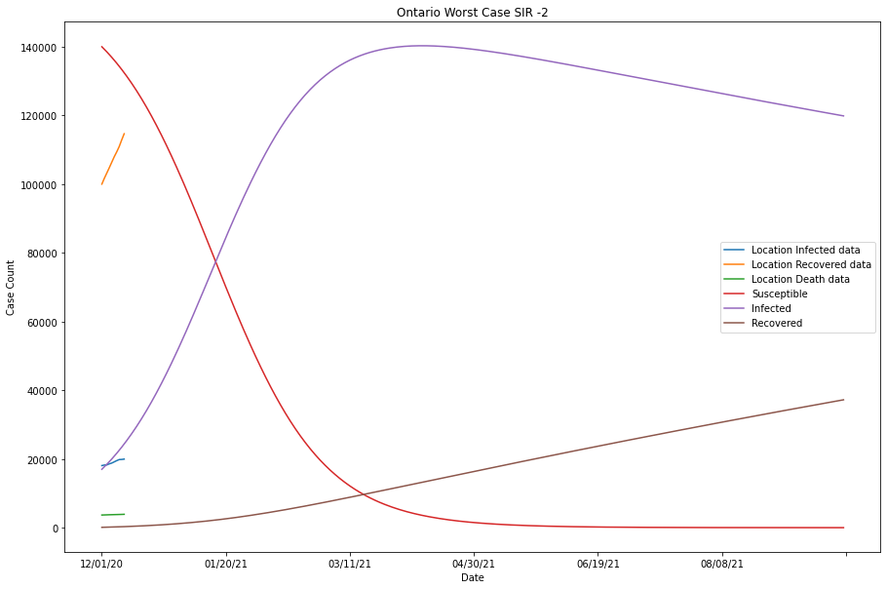
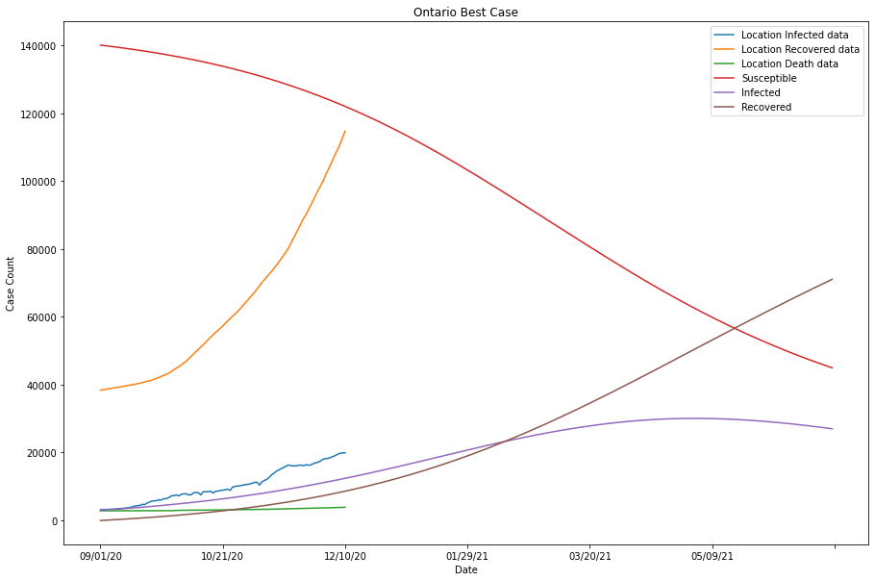
SIR Model – ALSO THE ONE WE SELECTED
Current Worst Best

